Slide 1
Distributed Systems and Computing
Clocks, Ordering and Election

Slide 2
Distributed Systems
Distributed Applications
Distributed Mutual Exclusion
Distributed File Systems
We are here
Consistency Models
Clocks, Logical Clocks, Vector Clocks and Causality
Distributed Middleware
Election and Coordination
(Byzantine) Fault Tolerance
OS
OS
OS
Hardware
Hardware
…………………..
Hardware

Slide 3
This Lecture
Physical time and clock drift
Logical Clocks
Lamport’s Algorithm
Vector Clocks
Leader Election Algorithms

Slide 4
Physical Clock
Centralized Systems
One or more processors share a common bus
Time synchronization is not much of concern
Distributed Systems
Each system has its own timer
Timers are based on oscillation of quartz crystal
These materials are not perfect and drift away from true time

Slide 5
Resynchronizing Clocks
Coordination of Physical Clocks
Possible, but can never be exact
Distributed algorithms should be tolerant to clock drift
A typical clock has relative error 10⁻⁵
100 ticks/second implies 360,000 ticks/hour normally
With error, 360,000 ticks/hour +- 4 ticks
In the worst case, two systems drift 8 ticks apart in an hour

Slide 6
Resynchronizing Clocks
Assume that we need to maintain all clocks in a distributed systems within 2 ticks. Given the data in the previous slide, how many times per hour do we need to synchronize all the clocks?
Err/h = ticks/h x error rate
Drifts = 2 x error/hour (drift apart)
Times/h to sync = 2 x error/h div (ticks deviate)
Ans here = 2 * 4 / 2 = 4 times per hour

Slide 7
Cristian’s Algorithm
Client sends a request to timeserver
Time server responds with a timestamp
Client synchronizes with the server provided timestamp
UTC Time Server
Time
Server
Client 1
Client 2
Client N

Slide 8
Cristian’s Algorithm
Sending and receiving request from a time server has non-negligible delay
It is assumed that on client’s end, the clock is accurate during this delay
Client computes time as:
Server timestamp + (response received timestamp – request dispatched timestamp)/2
Note the second component is computed with client’s clock
(response received timestamp – request dispatched timestamp) in short is also called RTT
Notes:
Add figure

Slide 9
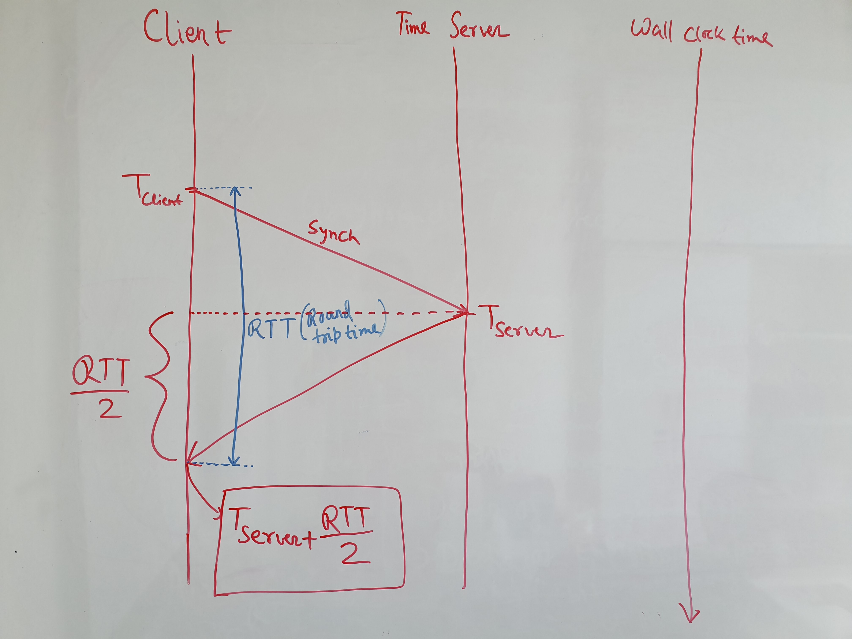
Cristian’s Algorithm

Slide 10
Cristian’s Algorithm
Time servers may have delay to process request
In such cases time needs to be adjusted taking into account server latency
Adjusted_Local_Clock
Server timestamp + (RTT – Server Latency)/2
Server Latency was accounted in the Server Timestamp when the time server had delay in processing requests
Notes:
Add figure

Slide 11
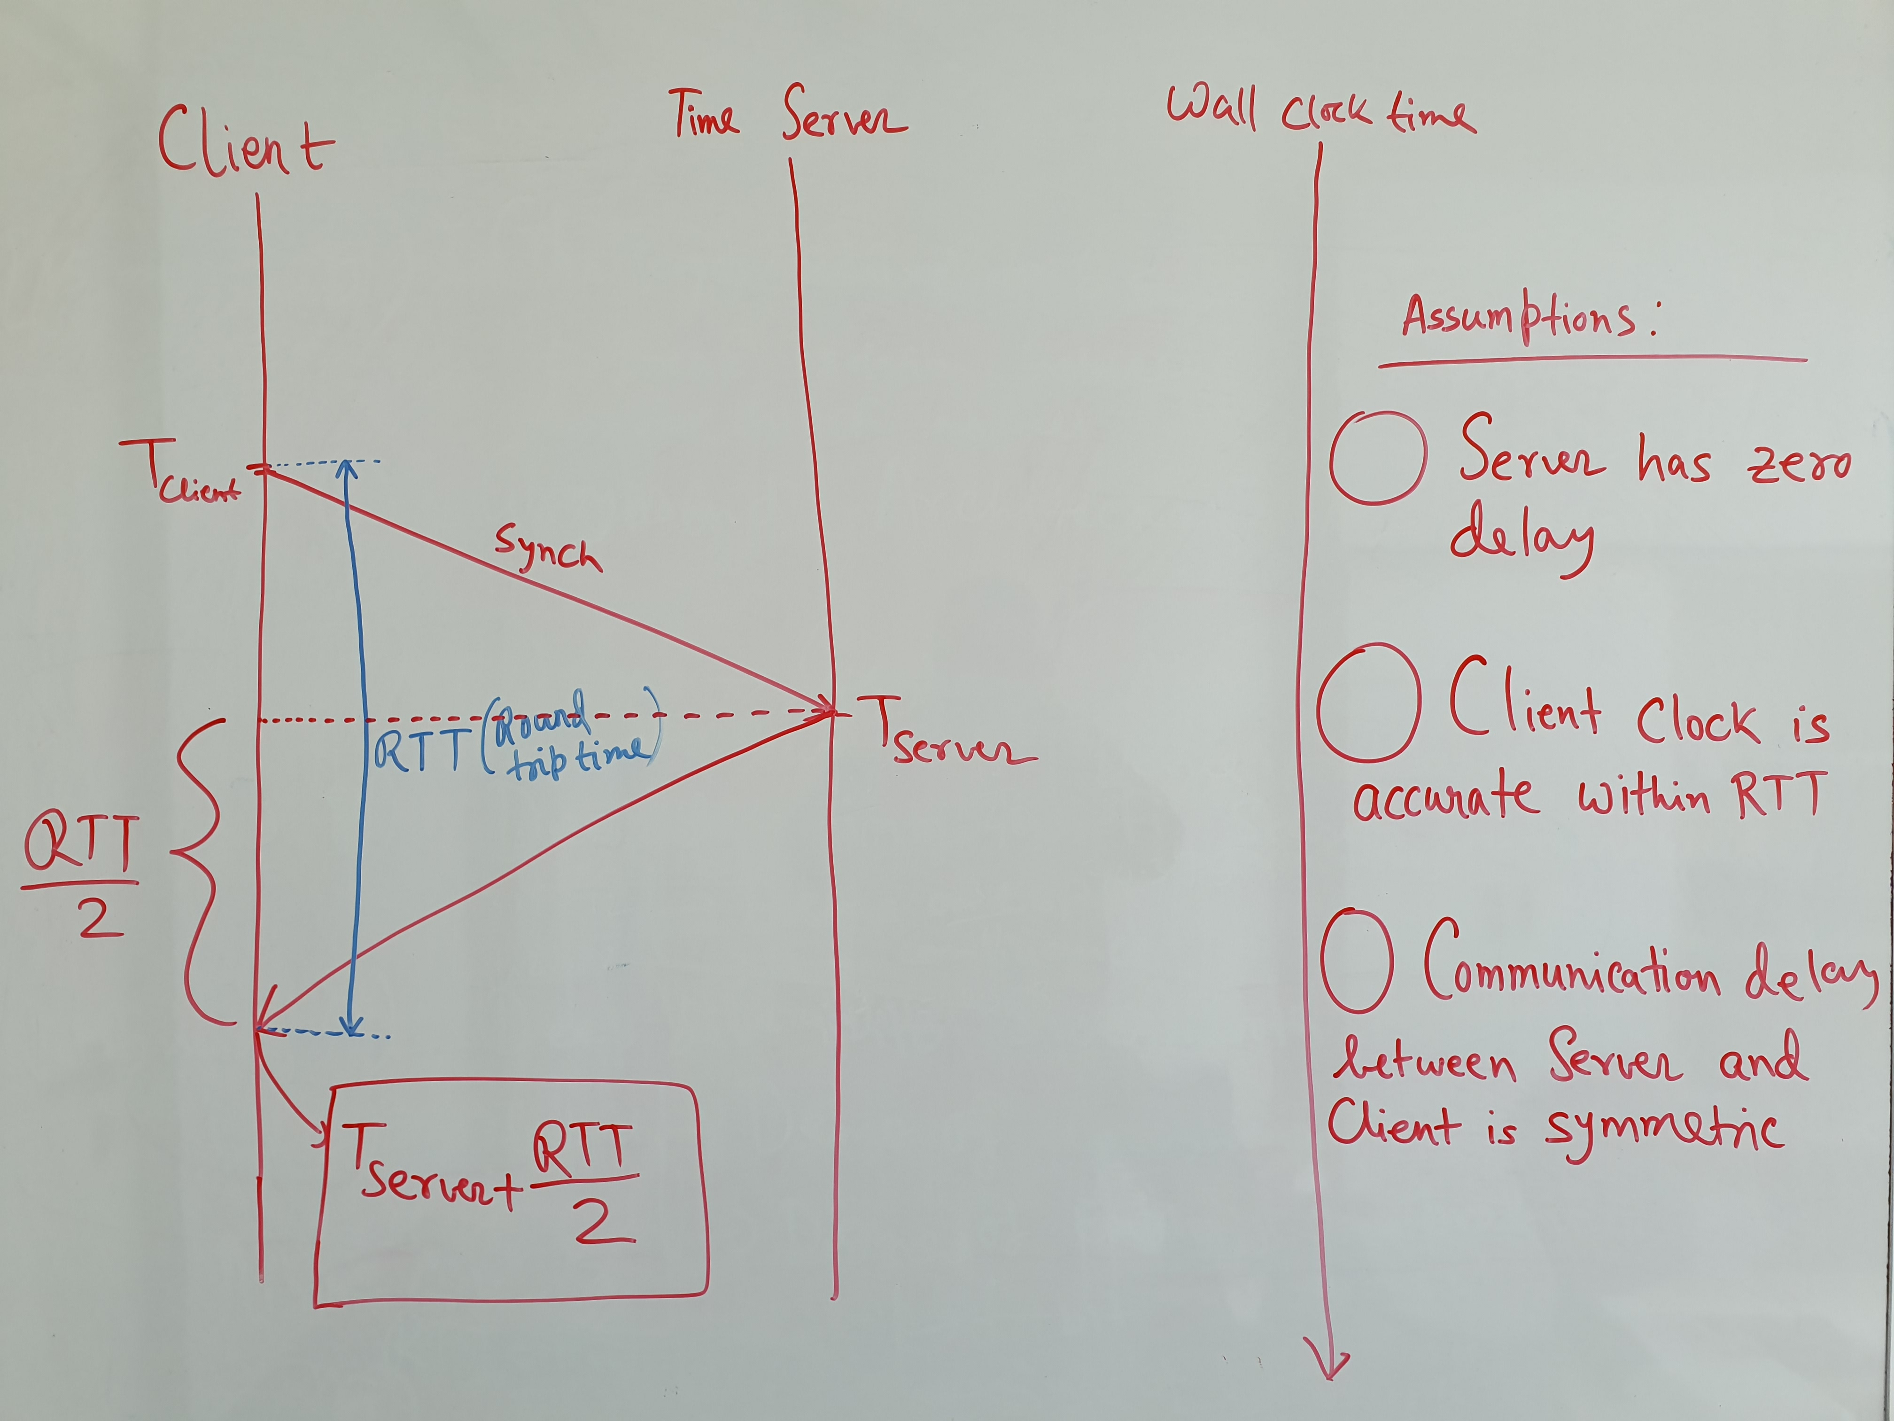

Slide 12
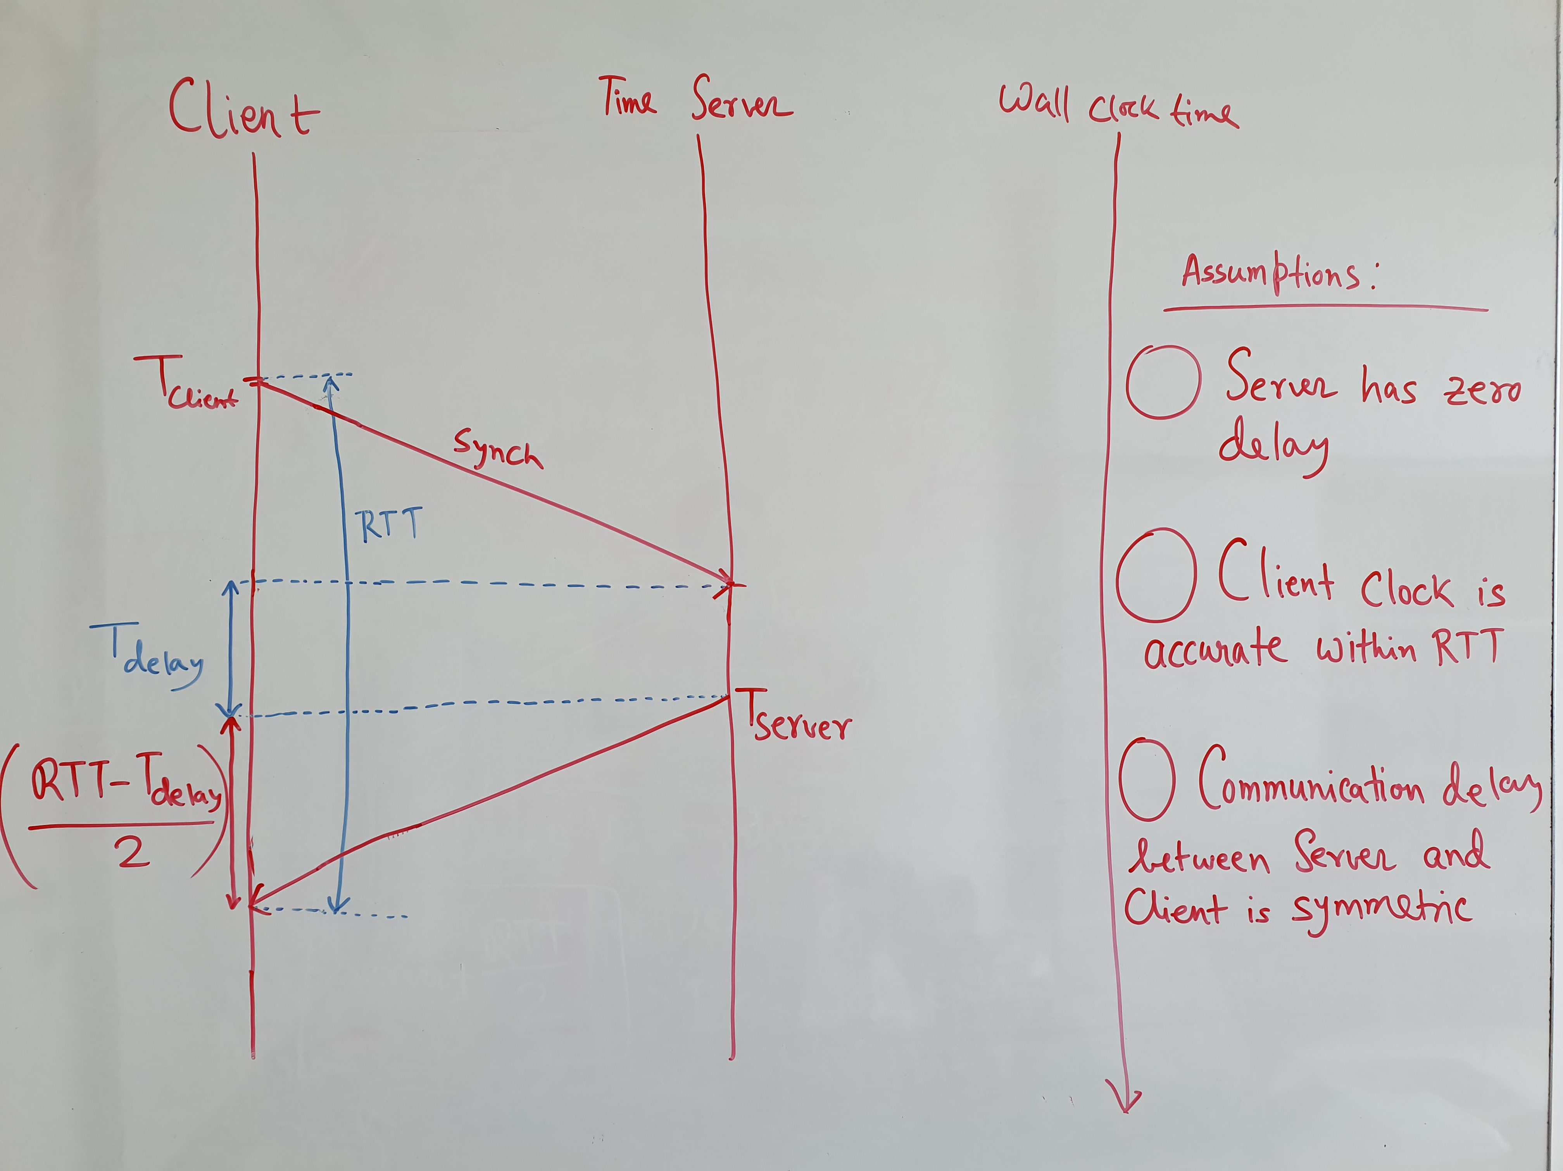

Slide 13
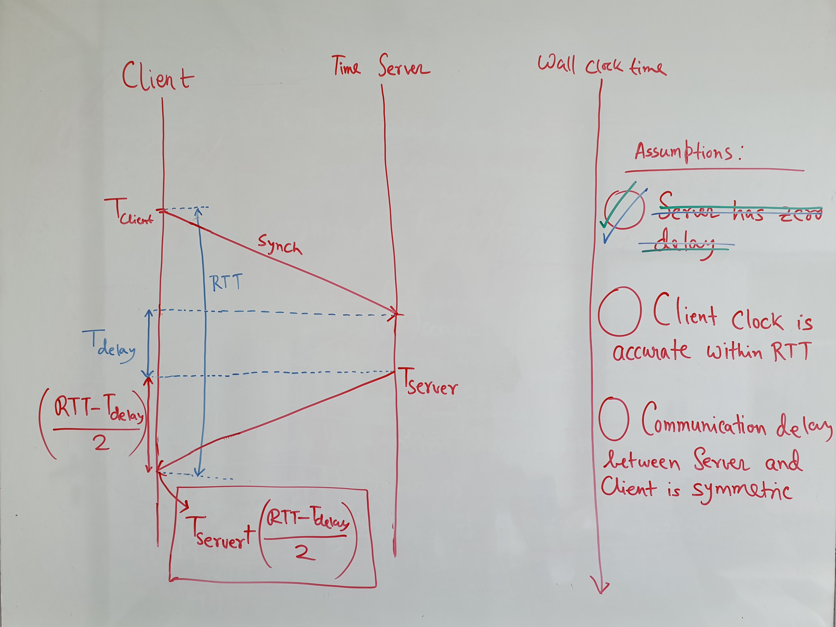

Slide 14
Cristian’s Algorithm
The algorithm assumes that communication delay between server and client is symmetric
In such cases, keep track of recent RTTs and repeat request when an RTT is an outlier
Otherwise, use an weighted average (of n measurements):
avg_local_clock_adjusted (0) = adjusted_local_clock
avg_local_clock_adjusted(n) =
(weight * adjusted_local_clock) + (1-weight) * avg_local_clock_adjusted(n-1)
Notes:
Less and less weights to previous measurements.

Slide 15
Cristian’s Algorithm (Caveats)
Assuming the average of adjusted_local_clock may average time considerably apart
For example, if adjusted_local_clock for two measurements are largely different according to wall clock time
It is better to take the average of the error:
Local_error = (adjusted_local_clock – current_local_clock)
avg_local_clock_error(0) = (Local_error)
avg_local_clock_error(n) = (weight * Local_error) + (1-weight) * avg_local_clock_error (n-1)
Adjusted_local_clock = current_local_clock + avg_local_clock_error(n)
Notes:
Less and less weights to previous measurements.

Slide 16
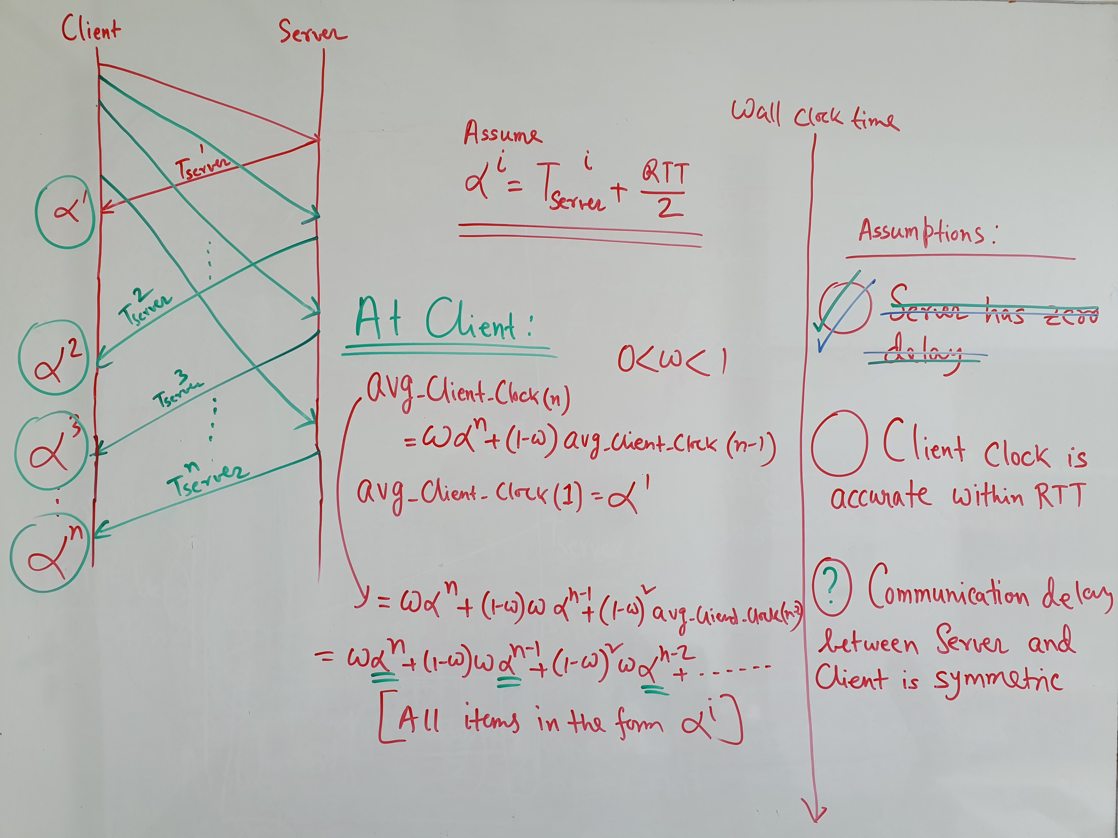

Slide 17
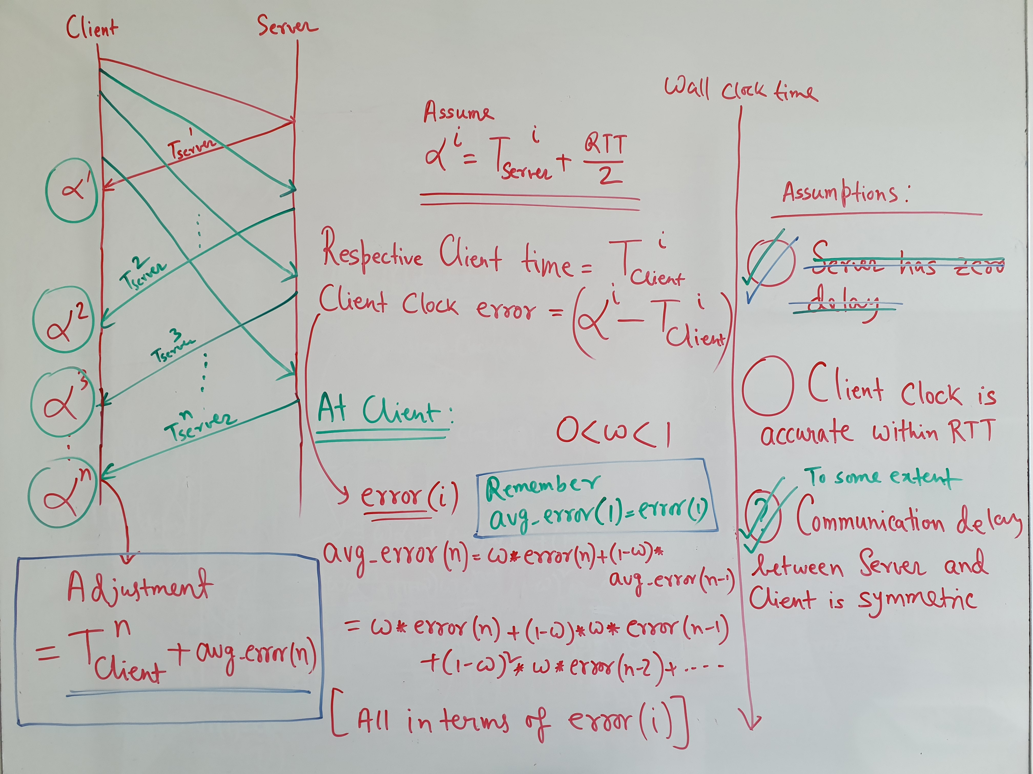

Slide 18
Caveats
Generally, clocks of a system can be advanced without causing much problems
However, if the clock is faster, adopting a prior time is not a good idea
Can disturb the order of events being sent
In such case, the clock should be slowed down, instead of adopting a prior time
Notes:
Like advancing clock means likely that we might need to execute some events faster, but prior time may mean events are already executed. Also introduce that Cristian’s algorithm has single point of failure and how election plays a role when you introduce multiple time servers.

Slide 19
Berkley Algorithm
Similar to Cristian’s but do not have a dedicated time server
Based on polling
A server polls all machine periodically and computes whether the machine should speed up or slow down
The polling period is set based on the maximum drift allowable for the systems
Instead of polling, the server can also broadcast to all machines

Slide 20
Berkley Algorithm
3. Adjust +0.05
Elected
Time
Server
Time = 3.00
2. Time = 3.25
2. Time = 2.50
1. Time?
1. Time?
Time = 3.25
3. Adjust -0.40
3. Adjust +0.35
Time = 2.50
Client 1
Client 2
Take RTT = 0.4s each
Formula = sum of all clocks + 1 RTT = 3.05 global
The time server averages out the time and make adjustment to the clock, including itself

Slide 21
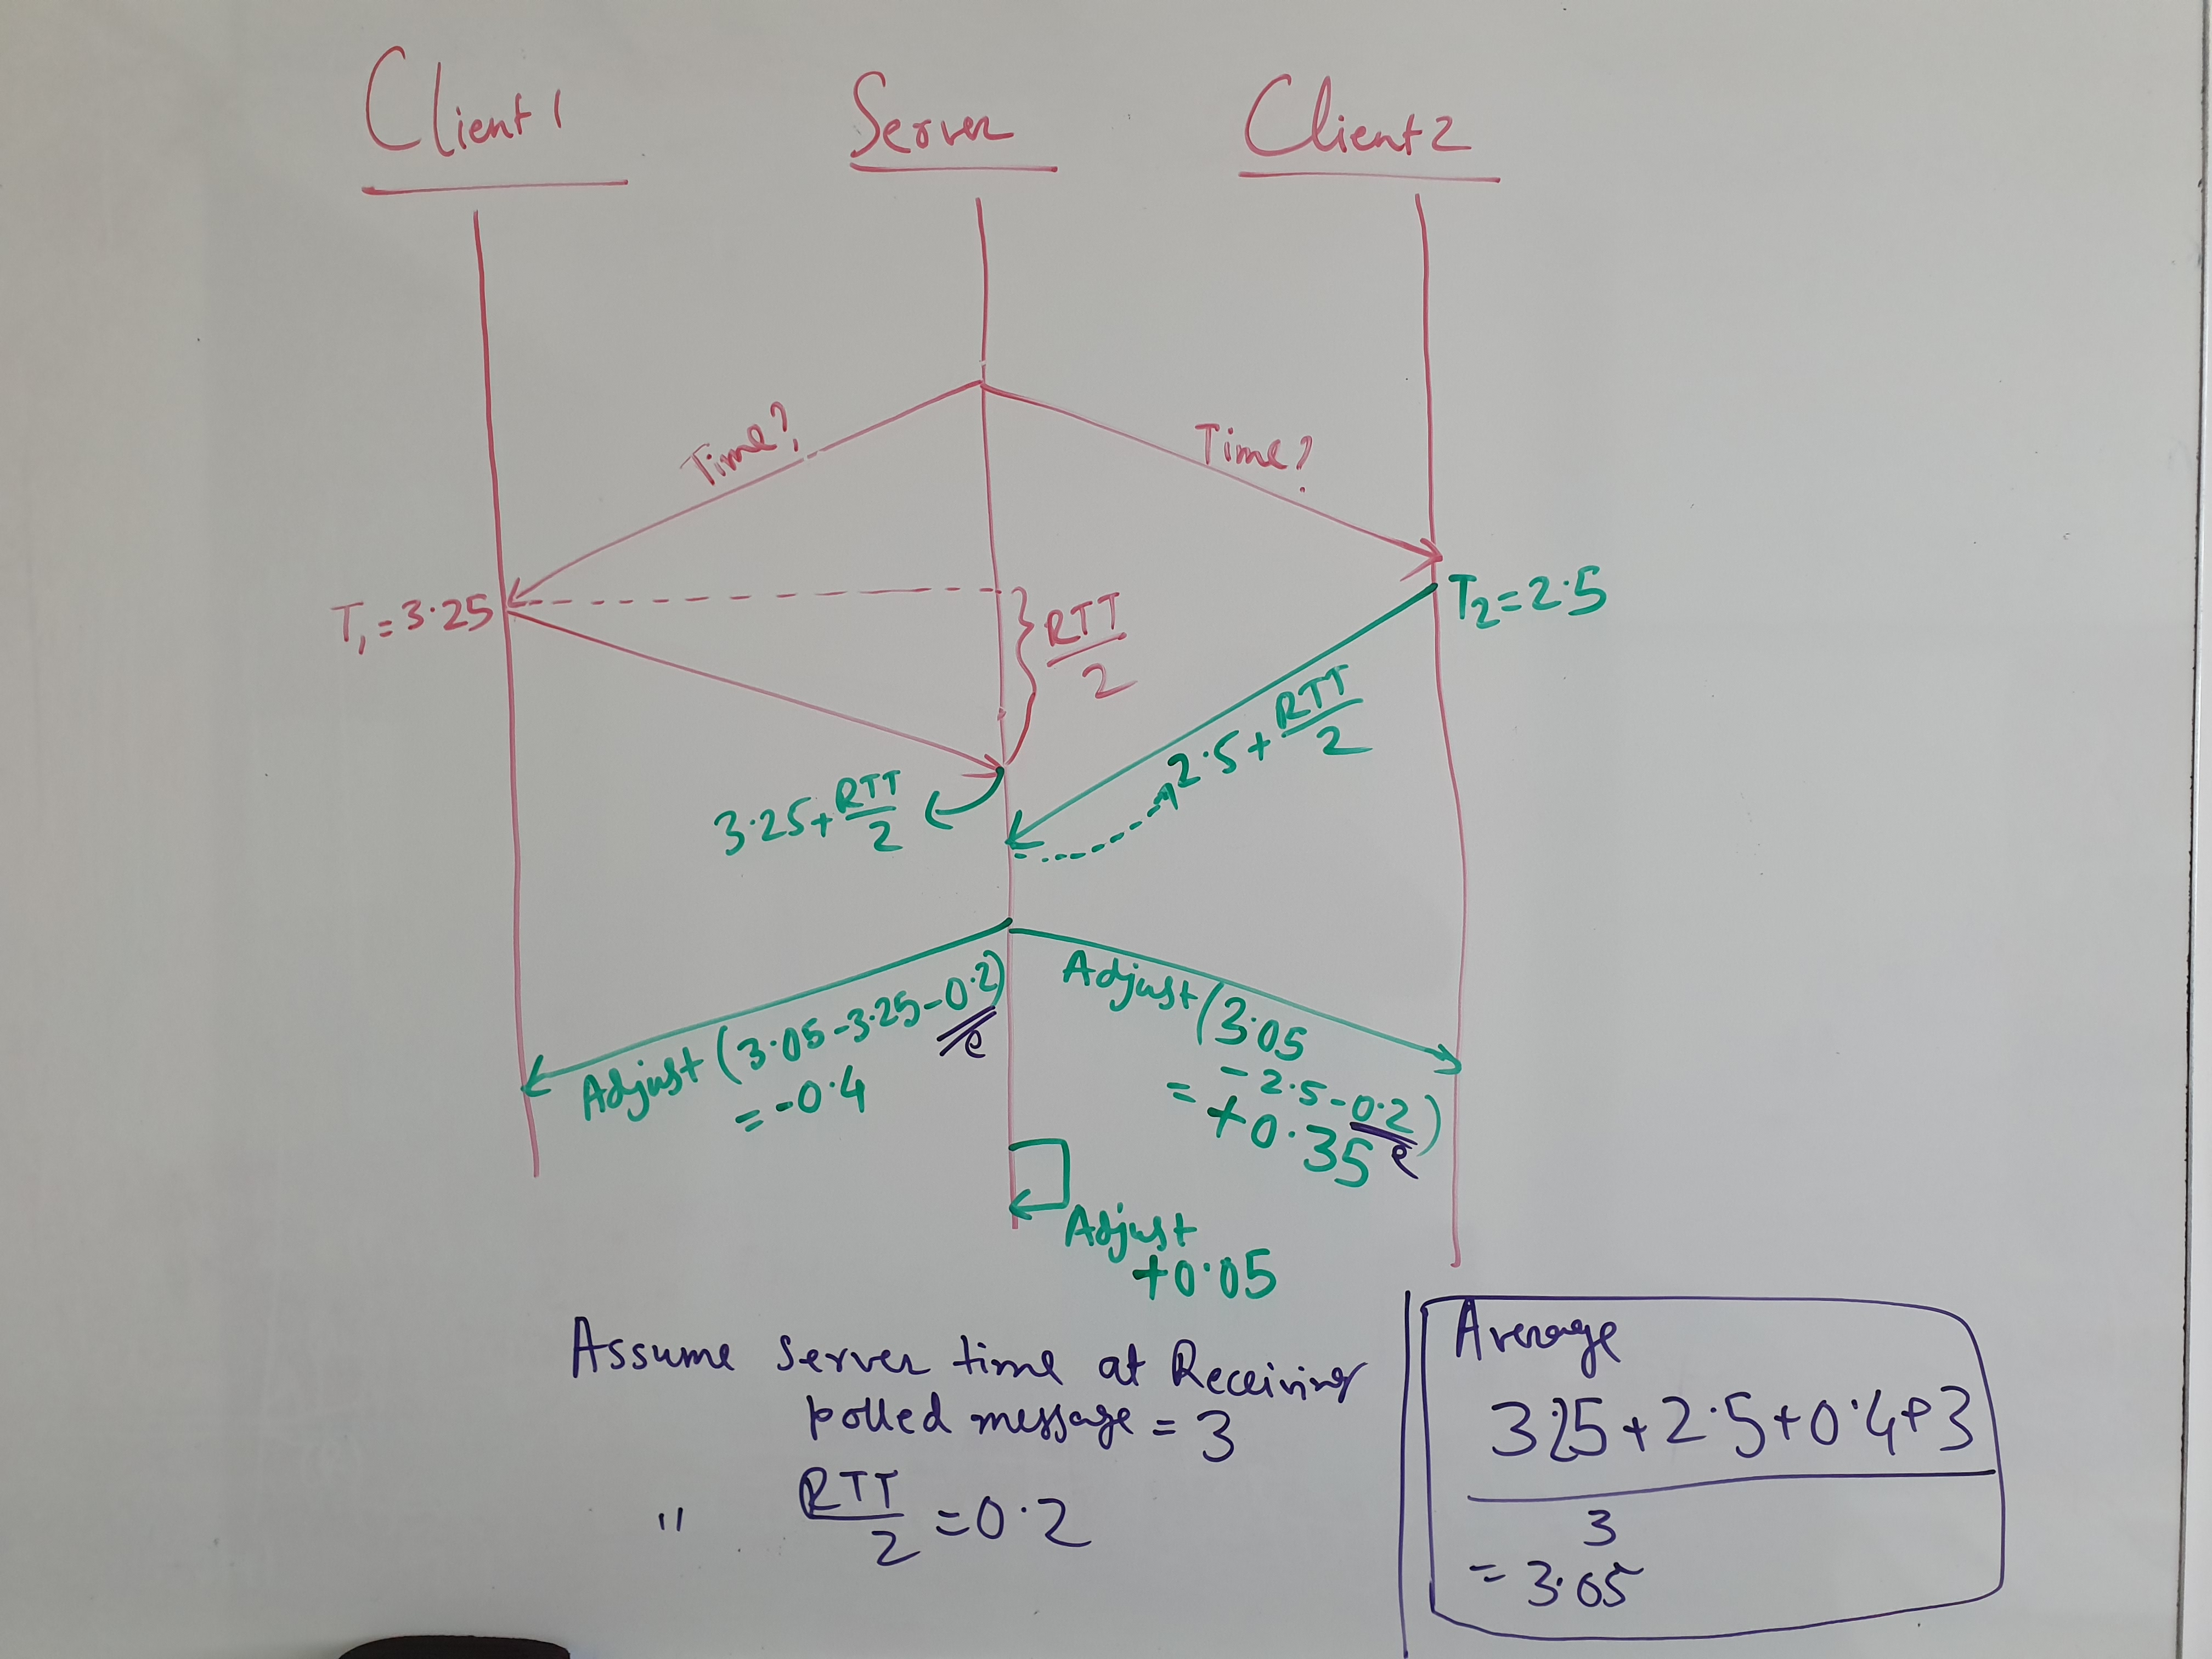

Slide 22
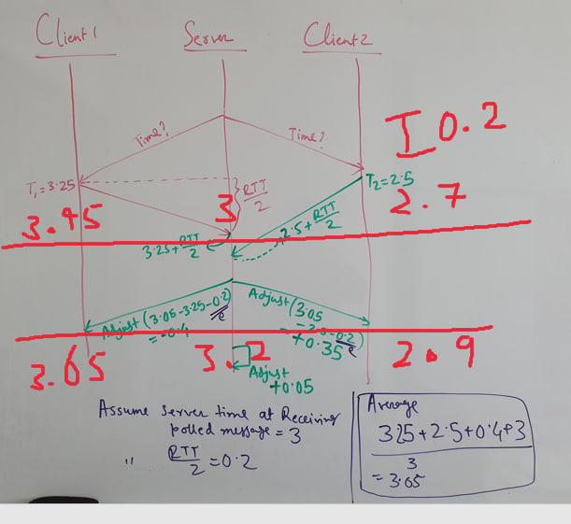
0.2 additional adjustment comes from the fact that at the very start, the clients are 0.2s forward when sending the time

Slide 23
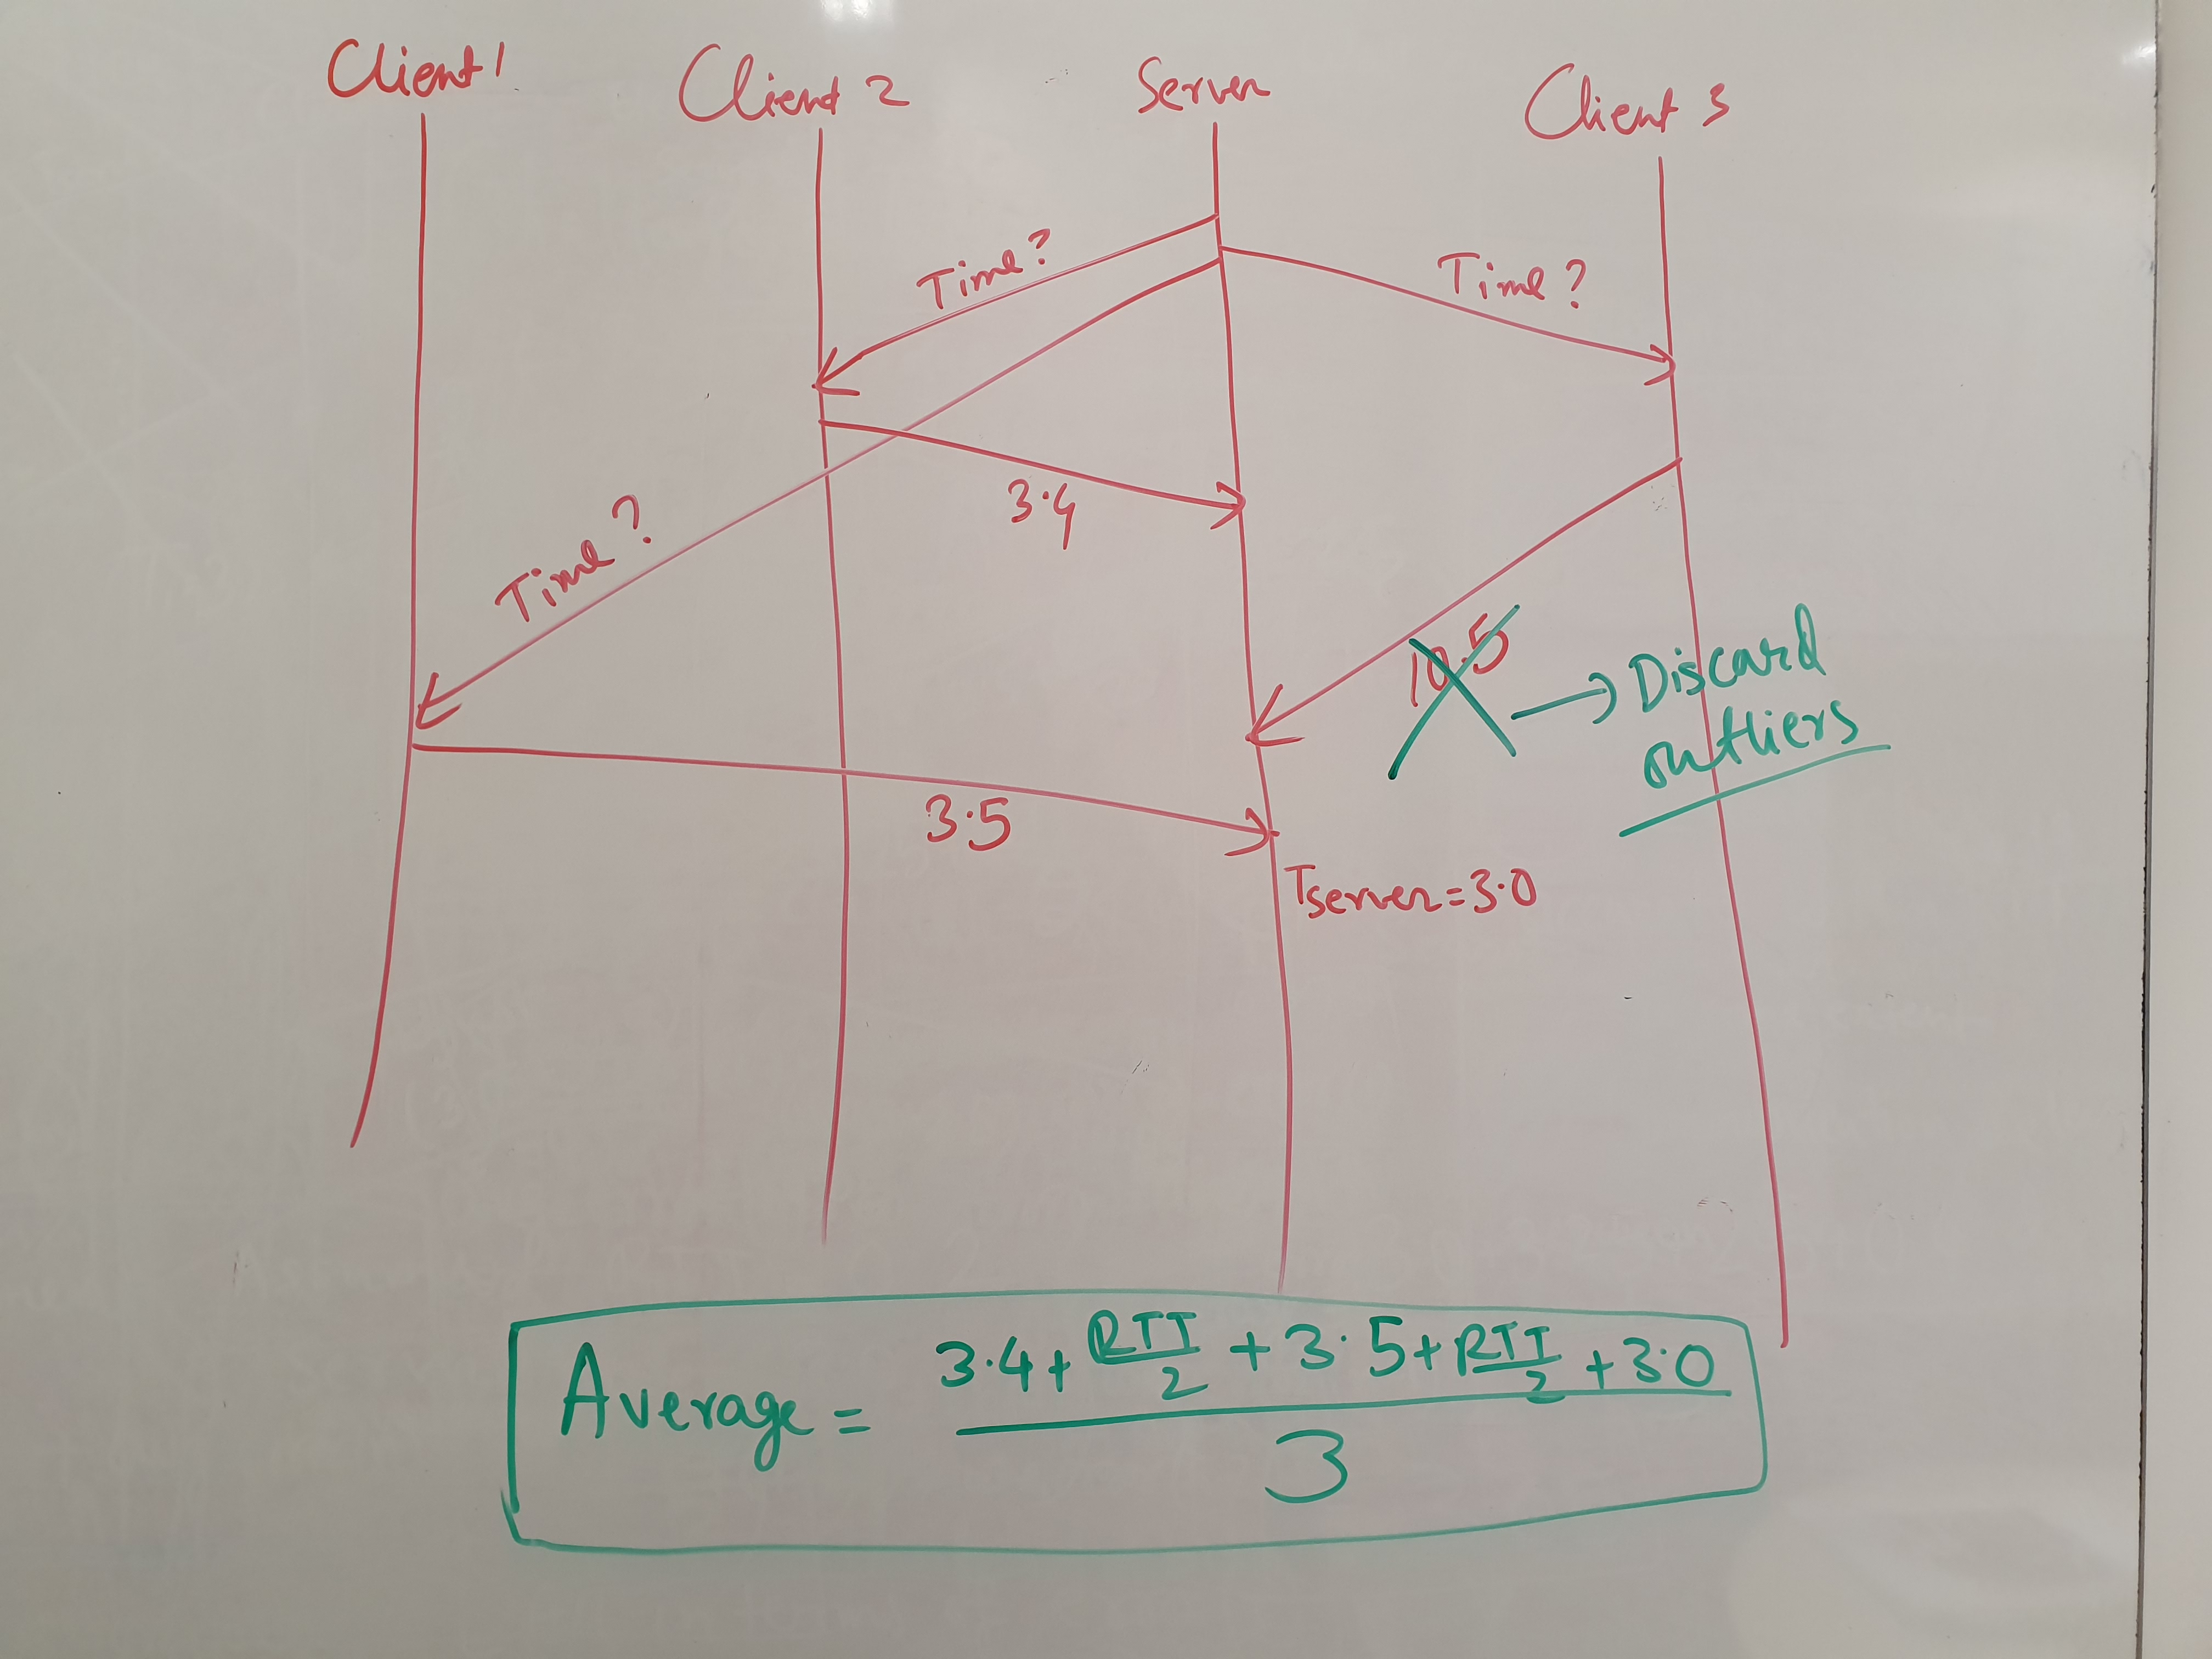
Discard Outliers

Slide 24
Real-world Synchronization
Network Time Protocol (NTP)
Instead of one time server, it uses a hierarchy of time servers arranged into strata
The first stratum contains servers with highly accurate time.
The second stratum servers synchronize with the first, the third stratum servers synchronize with the second and so on.
Higher = more accurate = less servers as well

Slide 25
Network Time Protocol (NTP)
Time Source (Highly accurate)
Stratum 1
Synch
Stratum 2
Synch
Stratum 3
Client
A client needs to synchronize
time with the time server

Slide 26
Network Time Protocol (NTP)
Time Source (Highly accurate)
Stratum 1
Vertical
Synch
Stratum 2
Horizontal
Synch
Stratum 3
Low stratum servers may communicate to synchronize and act as mutual backups for other servers in the same stratum

Slide 27
Network Time Protocol (NTP)
A client performs NTP packet exchanges with several servers
Preferred servers are with lower stratum and the highest quality of estimate (statistically computed based on the accuracy of the time server and network transit times).
A higher stratum server can be chosen if the respective communication is more reliable as compared to the same with a low stratum server.

Slide 28
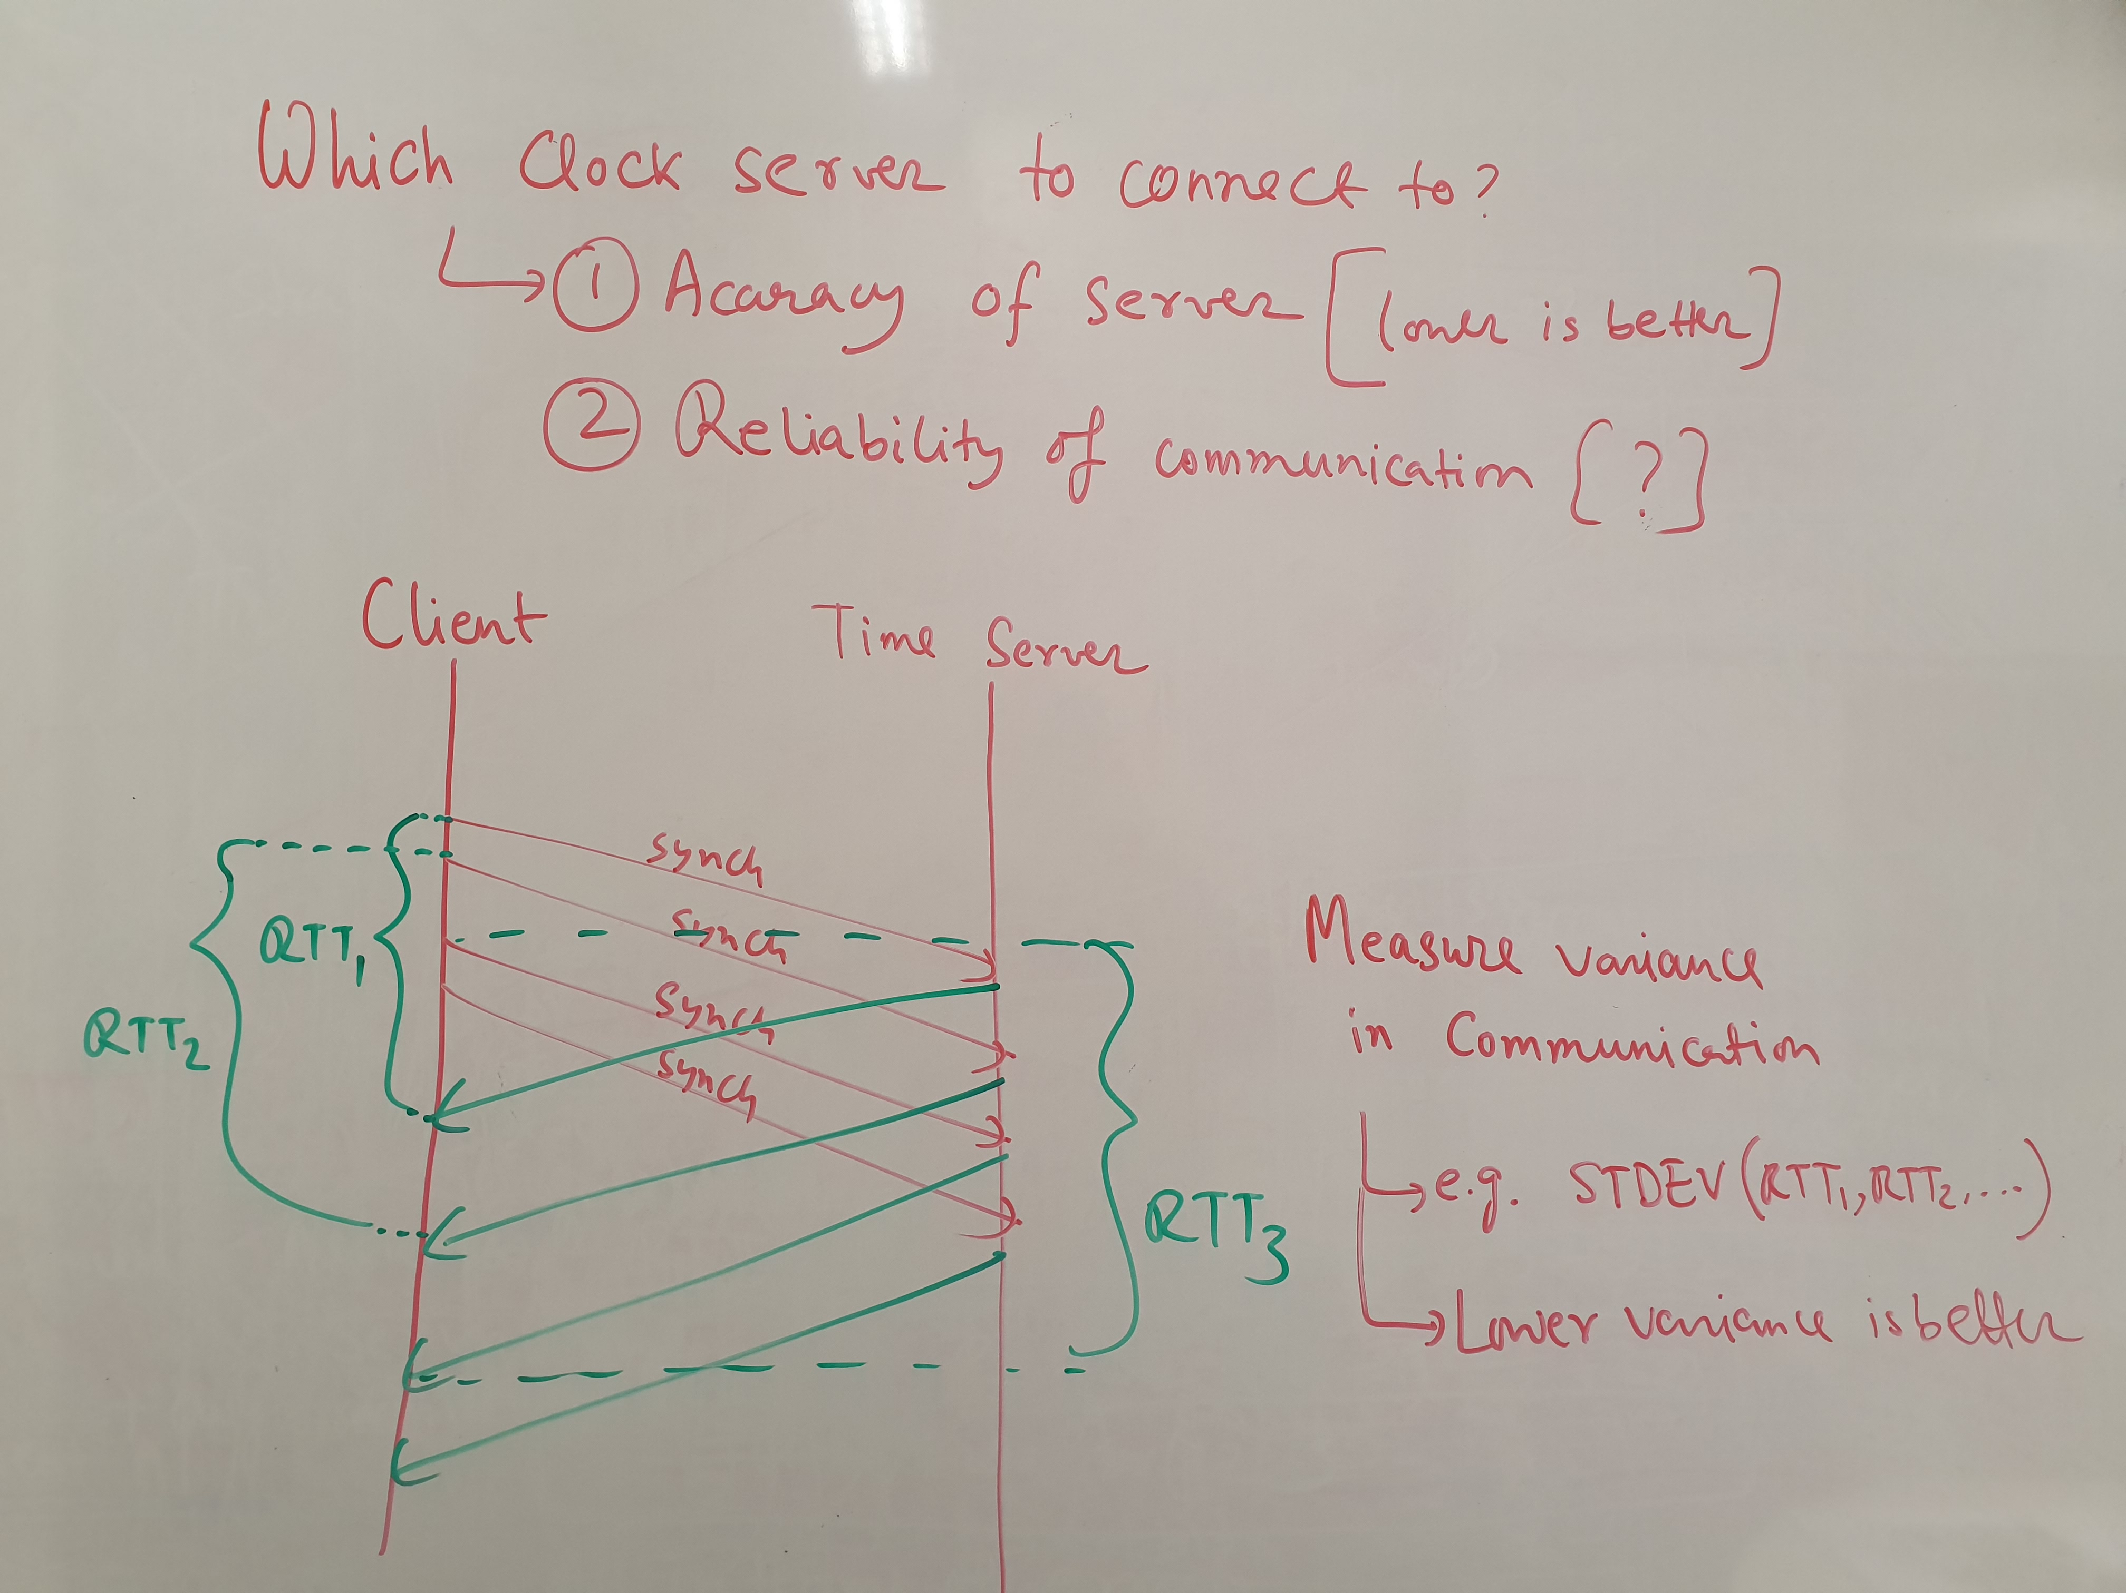

Slide 29
Network Time Protocol (NTP)
Synchronization with server
T1 = time request sent by the client
T2 = time request received by a a server
T3 = time reply sent by the server
T4 = time reply received by the client
Round trip delay (RTT) = (T4 – T1) – (T3 – T2)
Clock Offset/adjustment = (T3 + RTT/2) – T4

Slide 30
Real-world Synchronization
The basic algorithm is similar to what we describe, but has additional challenges
Challenges include
How to find a time server?
How to handle faults, e.g., if the chosen time server goes down
Can be partially solved by having multiple time servers
What if the time server or a client is compromised
Handling Byzantine Faults

Slide 31
Global Ordering of Events
Declaration
{0,1,null} x := null
Definition
A0: x != null -> {out := x; x := null}
A1: x := in
Boolean in
Boolean out
(Asynchronous Model)
If the two components are independent, we do not care
{0,1,null} x := null
A0: x != null -> {out := x; x := null}
A1: x := in
Boolean in
Boolean out
(Asynchronous Model)
With asynchrony, the two components may proceed in completely
different speed
Notes:
Say that in synchronous models it is easier, as we have the notion of a round or clock. We can use the concept of round to order events. Here the steps of two components might be quite different.

Slide 32
Logical Clocks
It is frequently unnecessary to know the exact time of an event in a distributed system
Often it is sufficient to know the order of events
Only the order of a few events need to be known
For example, events that are visible to multiple systems

Slide 33
Logical Clocks
{0,1,null} x := null
A0: x != null -> {out := x; x := null}
A1: x := in
Boolean in
Boolean out
(Asynchronous Model)
If the two components are independent, we do not care
{0,1,null} x := null
A0: x != null -> {out := x; x := null}
A1: x := in
Boolean in
Boolean out
(Asynchronous Model)
Each component maintains its own logical clock

Slide 34
Happens-before Relation
If A and B are events in the same component and A occurs before B, then A->B
For example {out := x} -> {x := null}
Also check(x != null) -> {out := x}
{0,1,null} x := null
A0: x != null -> {out := x; x := null}
A1: x := in
Boolean in
Boolean out
(Asynchronous Model)

Slide 35
Happens-before Relation
If A is a send message and B receives this message, then A->B
For example {send of out’} -> {receive of out’}
{0,1,null} x := null
{0,1,null} x := null
A0: x != null -> {out := x; x := null}
A1: x := in
A0: x != null -> {out := out’; x := null}
A1: x := in
Boolean
in
out’
Boolean
out
(Asynchronous Model)
(Asynchronous Model)
Notes:
Say that for synchronous model, you need to wait until the receive message finish. Hence, it is also expensive.

Slide 36
Happens-before Relation
If A->B (A happens before B) and B->C (B happens before C), then A->C (transitive)
If A->B is not true, then A and B may proceed concurrently. This means A and B may occur in any unknown order
This means that concurrent doesn’t need to happen in order

Slide 37
Happens-before Relation
If A occurs on P1 and B occurs on P2 and P1 and P2 have not exchanged messages, then A and B are said to be concurrent. Note this also includes the case where P1 and P2 does not exchange messages via a third party.
It is not possible to infer the order of A and B in this case
Notes:
Example

Slide 38
Lamport’s Logical Clock
Goal: assign timestamps to events such that if
A->B, then timestamp(A) < timestamp(B)
Each component “i” maintains a logical clock “Li”
When an event occurs locally at “i”, then “Li := Li+1”
When “i” sends a message to “j”, copy “Li” in the message
When “j” receives the message from “i”, “Lj := max (Li, Lj) + 1”
Notes:
Illustration

Slide 39
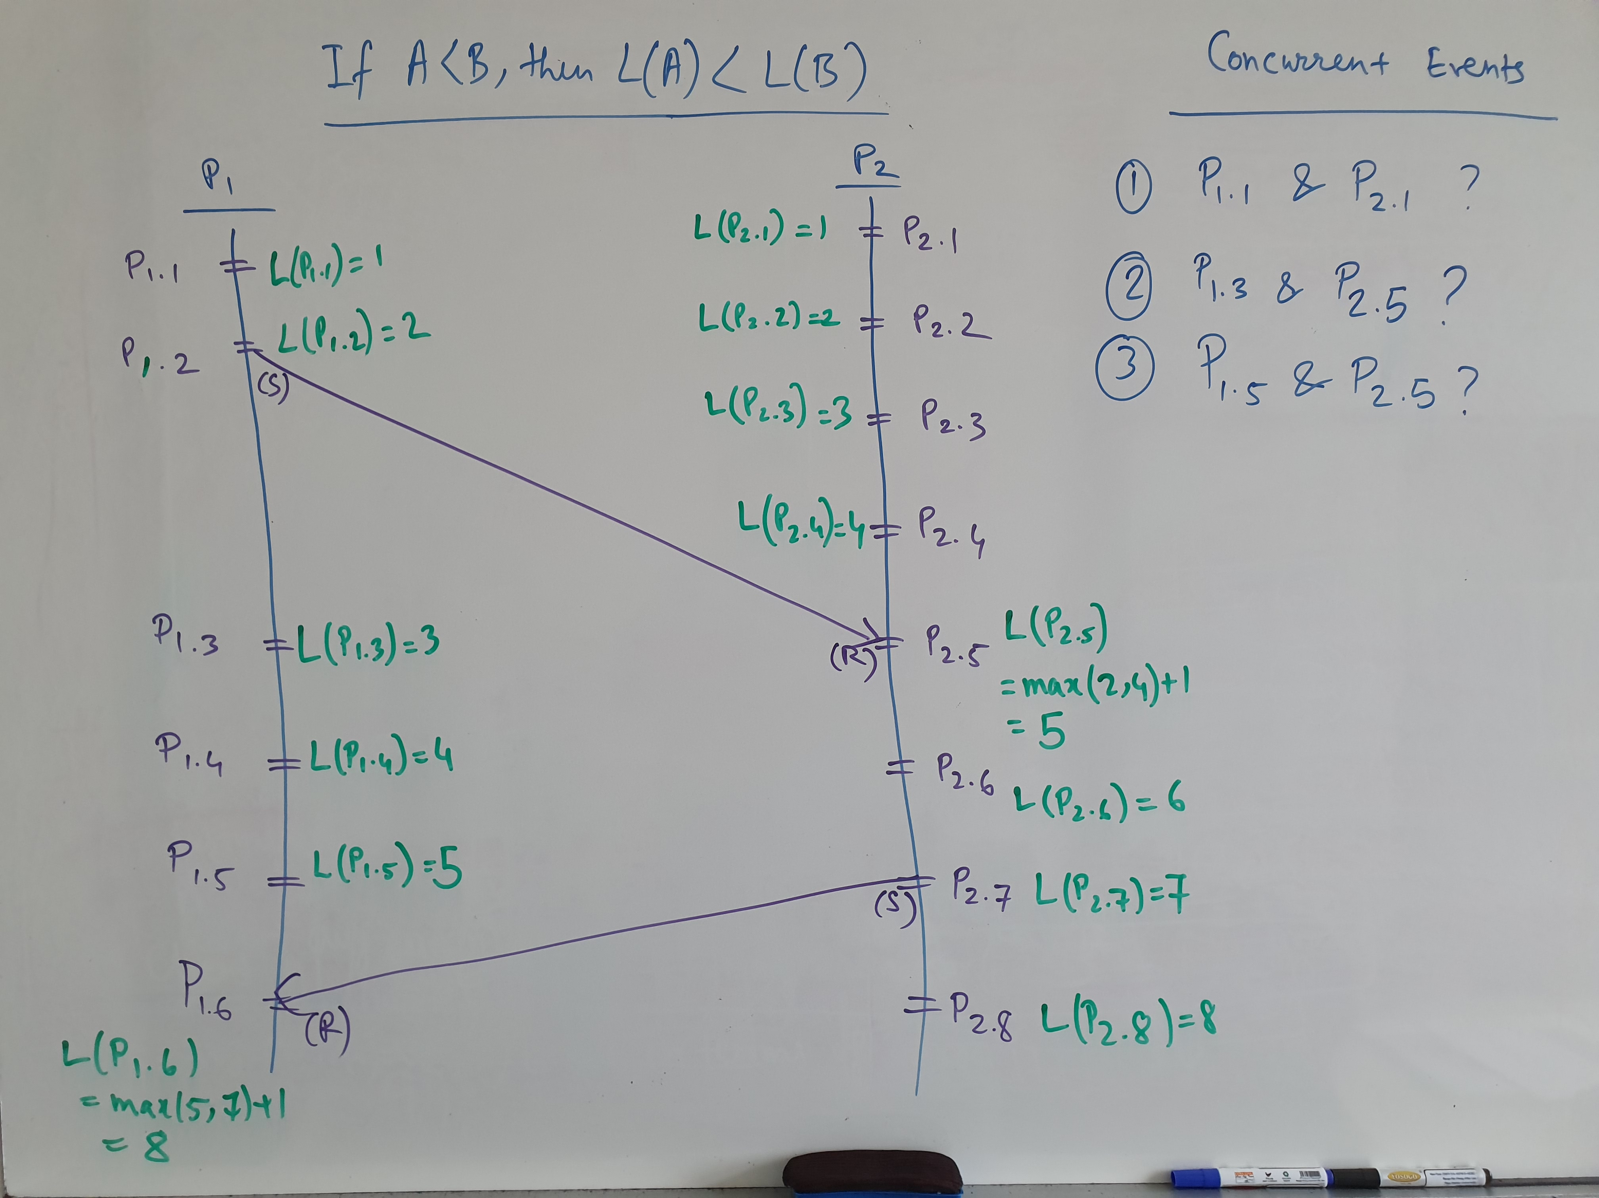
Yes
Yes
Yes

Slide 40
Quick Exercise
L1
P1
1
2
3
4
8
9
L2
P2
6
7
10
1
2
3
4
5
Which one is true?
If A->B, then LA < LB (yes)
If LA < LB, then A->B (No)

Slide 41
Total Ordering of Events
Lamport’s logical clock only provides a partial order
Concurrent events are allowed to occur at the same time
Break ties with the host or process ID
Notes:
Ask an example of a total order? Synchronization.

Slide 42
Total Order
L1
P1
1
2
3
4
8
9
L2
P2
6
7
10
1
2
3
4
5
A global clock C_{i.j} is captured via Pi.Lj
C_{i.j} < C_{m.n} iff Lj < Ln or (Lj=Ln and Pi < Pm)
Notes:
Say it does not matter which of the event “2” happens before, as they are concurrent. And show the difference with physical clock synch.

Slide 43
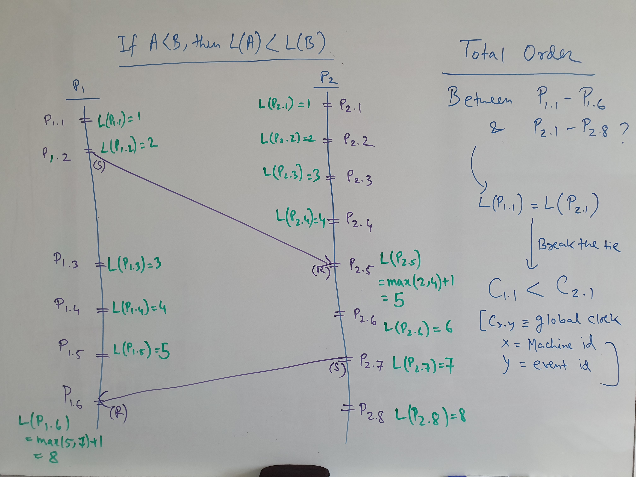

Slide 44
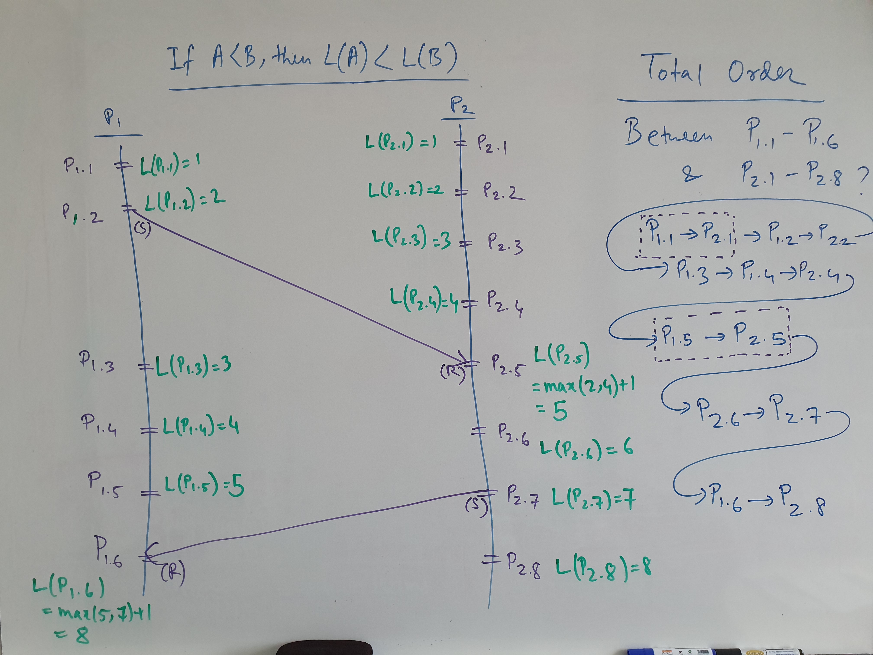

Slide 45
Causality Violation (Cause)
Lamport’s logical clock can be used for a total ordering
However, it might not consider cases whether all messages are received in the exact same order in all machines
For example, P1 may receive A first and then B, whereas P2 might receive B first before A
This may cause certain causality violation

Slide 46
Causality Violation (Cause)
Causality Violation occurs when
A causality violation occurs when a message ordering problem results in one host taking an action based on information that another host has not yet, but should have, received.
In our example, P₃ is trying to invoke a method on P₂, because P₃ thinks that P₂ has Obj.

Slide 47
Causality Violation (Instance)
1 (send P2 an object Obj)
2 (inform P3 to request P2 about Obj)
3
4 (call Obj.foo())
5
Fail
6
P2 gets Obj after
its request
P1
P2
P3
If the response from P3 to P2 is due to the message (3) from P1, this may cause problems

Slide 48
Exercise
Take a moment to check the previous example. Use the total ordering protocol via Lamport’s logical clock. Explain why or why not such causality violation might be detected by Lamport’s logical clock.
Notes:
Lamport's logical clocks provide a partial ordering of events in a distributed system based on the causality between events. They ensure that if one event causally affects another, then the first event will have a smaller timestamp than the second event. This is the "happens-before" relationship. However, Lamport's logical clocks do not provide a total ordering of all events because they do not assign timestamps that can be used to order events that are concurrent (where neither event causally affects the other).

Slide 49
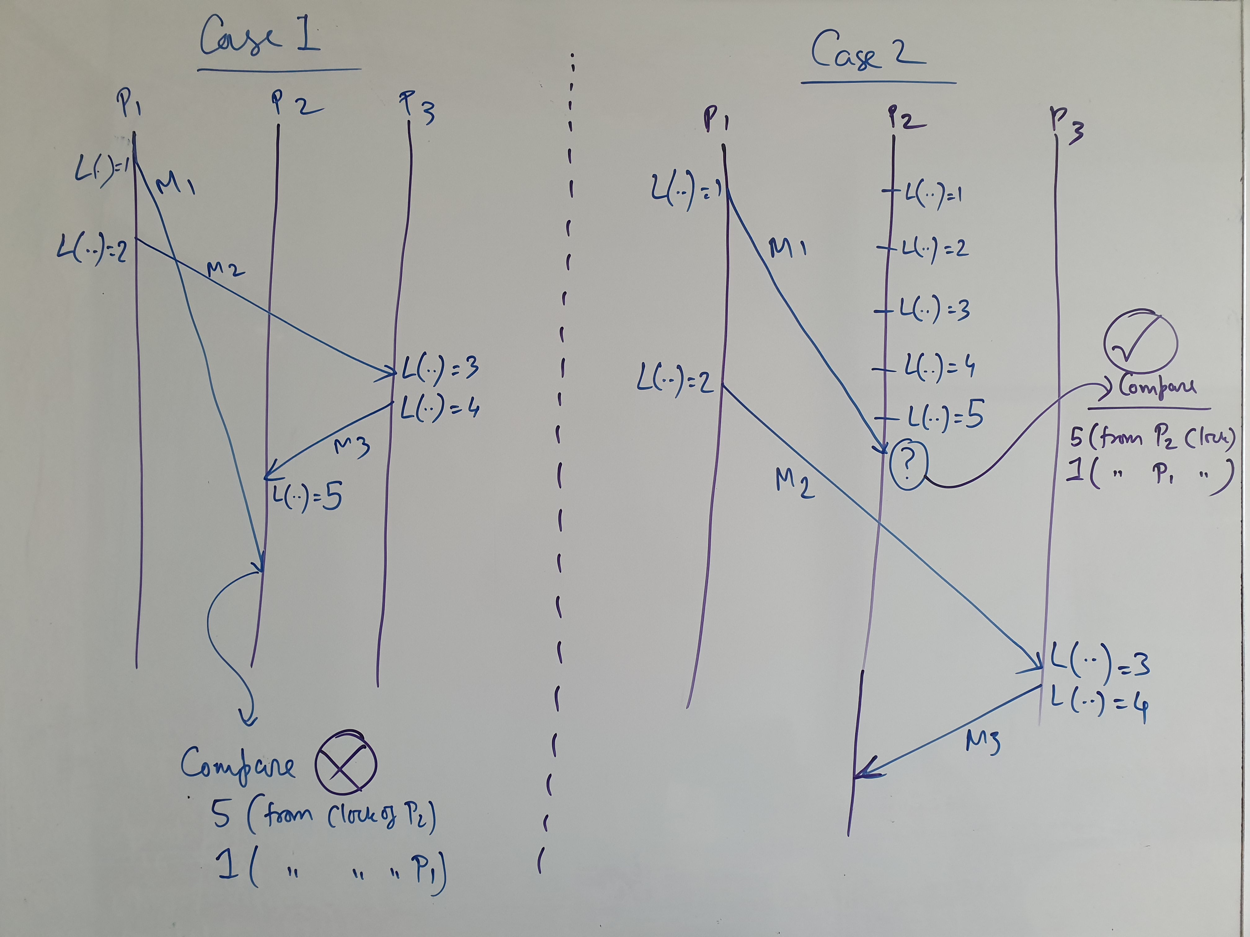

Slide 50
Potential Causality Violation
In designing systems we assume that
Any action a host takes may be affected by any message it has previously received.
We note that making such a definition more specific would require application specific knowledge
This not only makes the design of distributed system protocol general, but also much simpler.

Slide 51
Potential Causality Violation (Instance)
1 (send P2 an object Obj1)
2 (inform P3 to request P2 about Obj1)
3
4 (call Obj2.foo())
5
Fail
P2 gets Obj1 after
obj2 request
6
P1
P2
P3
Here, obj1 and obj2 are independent, yet they are considered in potential causality violation
Notes:
1->2, 2->3, 3->4. Therefore, 1->4.

Slide 52
Potential Causality Violation
The intuition behind the protocol
Determine whether messages were sent and received in the same order across all nodes in the system.
Thus, if an arbitrary machine P receives M₂ before M₁, but M₁ was sent before M₂, then a (potential) causality violation has occurred.

Slide 53
Design of Protocol (Vector Clock) (checking causality violation)
Vector Logical time extends Lamport’s logical clock, which was a scalar variable for each event
The vector contains the last known event count for each and every host
The only entry in the vector, that is guaranteed to be up-to-date, is for the sender of a message
Since all systems proceed asynchronously, the sender and the receiver may have different vector clocks

Slide 54
Protocol Design (Vector Clock)
Instead of just keeping our logical time, we keep a vector, V[], such that V[P] represents what we know of the logical time on processor P.
V[current_processor_id] is the logical clock for the current processor

Slide 55
Protocol Design (Send Operation)
Send the entire vector V[] with each message.
On send, increment time component for self. Send the updated timestamp vector with the message.

Slide 56
Protocol Design (Receive Operation)
On receive, merge both vectors, i.e. one from the sender and the other at the receiver. For each element in the vector, select the greater of the corresponding elements from each. Then increment the component for self.
Say V0[] and V1[] are the sender and receiver vector clocks. For any P, set V1[P] as the max(V0[P], V1[P])

Slide 57
Vector Clocks (Instance)
(0,0,0)
(0,0,0)
(0,0,0)
(1,0,0)
(2,0,0)
M2: (2,0,0)
1. Merge: (2,0,0)
and (0,0,0)
2. Increment Self
M1: (1,0,0)
(2,0,1)
M3: (2,0,2)
(2,0,2)
(2,1,2)
1. Merge: (2,0,2)
and (0,0,0)
2. Increment Self
1. Merge: (2,1,2)
and (1,0,0)
2. Increment Self
(2,2,2)
P1
P2
P3
Vector clock is captured as (Logical clock of P1, Logical clock of P2, Logical clock of P3)

Slide 58
Properties of the Protocol
Comparison of vector timestamps is crucial for the detection of causality violation
Comparing scalar variables is a trivial operation
Comparing vector clocks/timestamps require element-wise comparison

Slide 59
Comparing Vector Clocks
Property 1:
If corresponding elements in two vector clocks are identical, then the two events are the same event
Vector clocks of different events should never be identical
Notes:
Note: This is different from Lamport’s basic logical clock assignment protocol.

Slide 60
Vector Clocks (Instance)
(0,0,0)
(0,0,0)
(0,0,0)
(1,0,0)
(2,0,0)
M2: (2,0,0)
1. Merge: (2,0,0)
and (0,0,0)
2. Increment Self
M1: (1,0,0)
(2,0,1)
M3: (2,0,2)
(2,0,2)
(2,1,2)
1. Merge: (2,0,2)
and (0,0,0)
2. Increment Self
1. Merge: (2,1,2)
and (1,0,0)
2. Increment Self
(2,2,2)
P1
P2
P3
Check how Property 1 is being satisfied

Slide 61
Comparing Vector Clocks
Property 2:
If A "happens before" B then each element of A’s vector clock is less than or equal to the corresponding element in B’s vector clock, and at least one element is less than the corresponding element in B’s vector clock.
Similarly stated if B “happens after” A.
Notes:
Explain the reason that the merge takes maximum and then increments the local clock.

Slide 62
Vector Clocks (Instance)
(0,0,0)
(0,0,0)
(0,0,0)
(1,0,0)
(2,0,0)
M2: (2,0,0)
1. Merge: (2,0,0)
and (0,0,0)
2. Increment Self
M1: (1,0,0)
(2,0,1)
M3: (2,0,2)
(2,0,2)
(2,1,2)
1. Merge: (2,0,2)
and (0,0,0)
2. Increment Self
1. Merge: (2,1,2)
and (1,0,0)
2. Increment Self
(2,2,2)
P1
P2
P3
Check the vector clocks of Send and Receive events for Property 2

Slide 63
Comparing Vector Clocks
Property 3:
If two events are concurrent, they will have "mixed" vector clocks such that at least one pair of corresponding elements is "greater than" and at least one corresponding pair of elements is "less than.“
One more than, one less than. Also if all equals
(0, 1) & (1, 0)
Notes:
Event A is concurrent with event B if and only if:
Vector clock of A is not less than or equal to the vector clock of B (A≰ B )
Vector clock of B is not less than or equal to the vector clock of A (B≰ A )

Slide 64
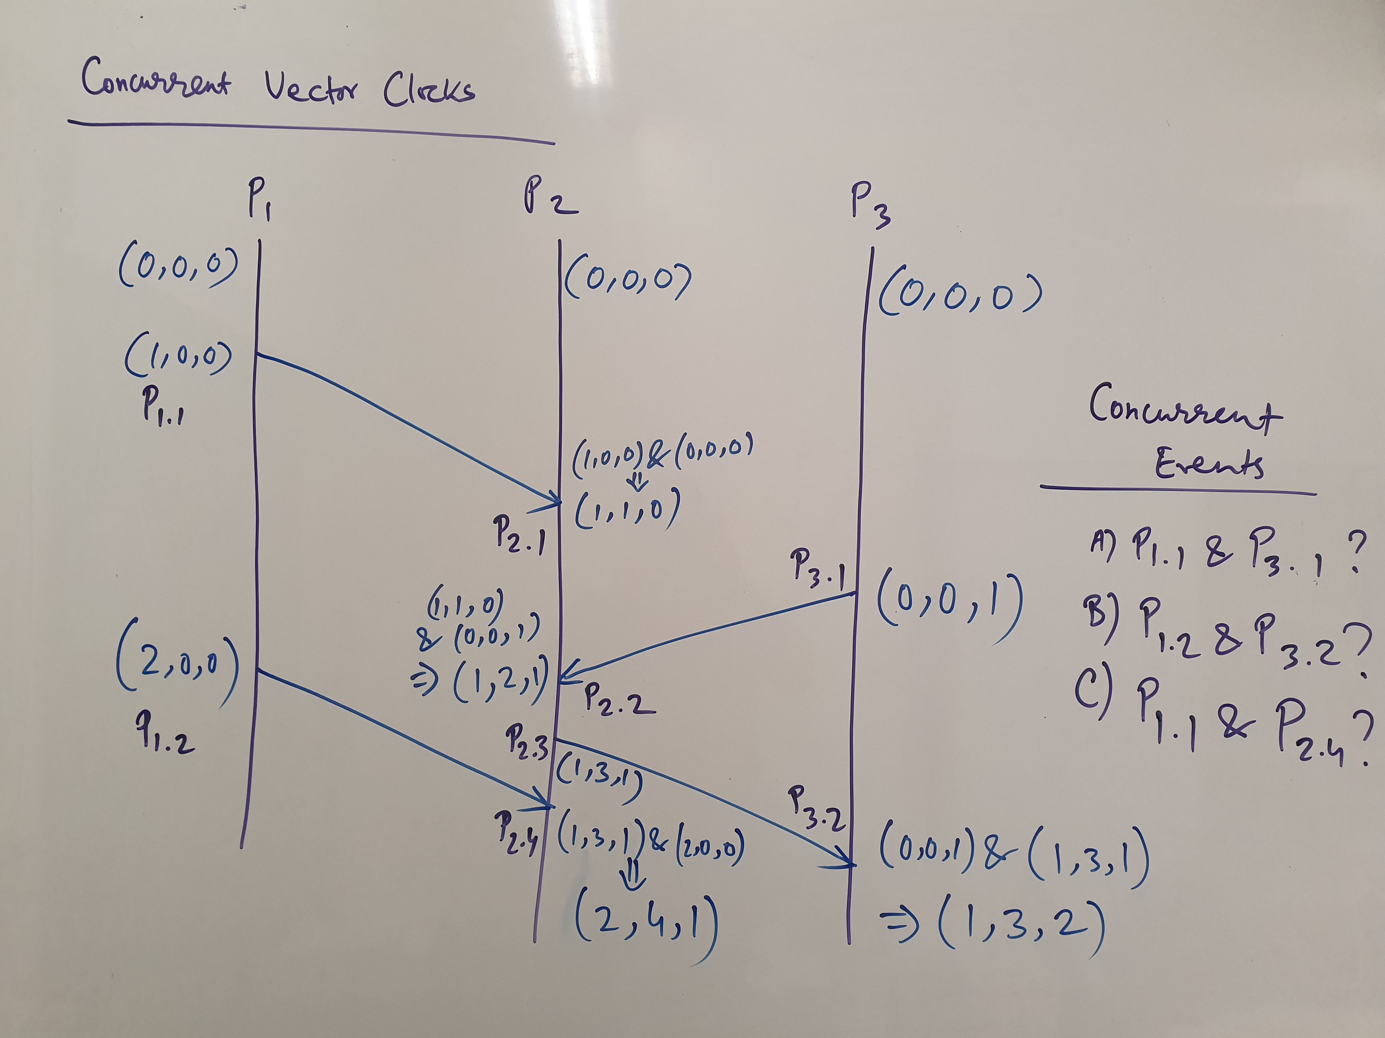
yes
yes
No

Slide 65
Detecting Causality Violation (Instance)
(0,0,0)
(0,0,0)
(0,0,0)
(1,0,0)
(2,0,0)
M2: (2,0,0)
1. Merge: (2,0,0)
and (0,0,0)
2. Increment Self
M1: (1,0,0)
(2,0,1)
M3: (2,0,2)
(2,0,2)
(2,1,2)
1. Merge: (2,0,2)
and (0,0,0)
2. Increment Self
1. Merge: (2,1,2)
and (1,0,0)
2. Increment Self
(2,2,2)
P1
P2
P3
When receiving a message, check for causality violation
If the local vector clock of the receiving machine is more than the vector clock
Of the message, then a potential causality violation is detected.

Slide 66
Detecting Causality Violation (Protocol)
Upon receiving a message, its vector clock (recall that the vector clock is associated with each sent message) is checked with the local clock.
If the local clock is after (in line with ANY OF the vector comparison) the message clock, then a causality violation is flagged.

Slide 67
Detecting Causality Violation (Intuition)
For the local (say P2) time to have advanced such that it is ahead of the vector clock of the newly received message (say M1), a prior message (say M3) must have advanced the local time.
The sender (say P3) of that prior message (i.e. M3) must have received the newly arrived message (i.e. M1) or a message sent after M1, before it sent its prior message M3 to the local (P2).
Thus a (potential) causality violation occurred.
Note that P3 receives M1 or a message sent after M1 before sending M3
Sending M1 is always before the reception of M1
P2 receives M1 after receiving M3, thus after M1 was sent

Slide 68
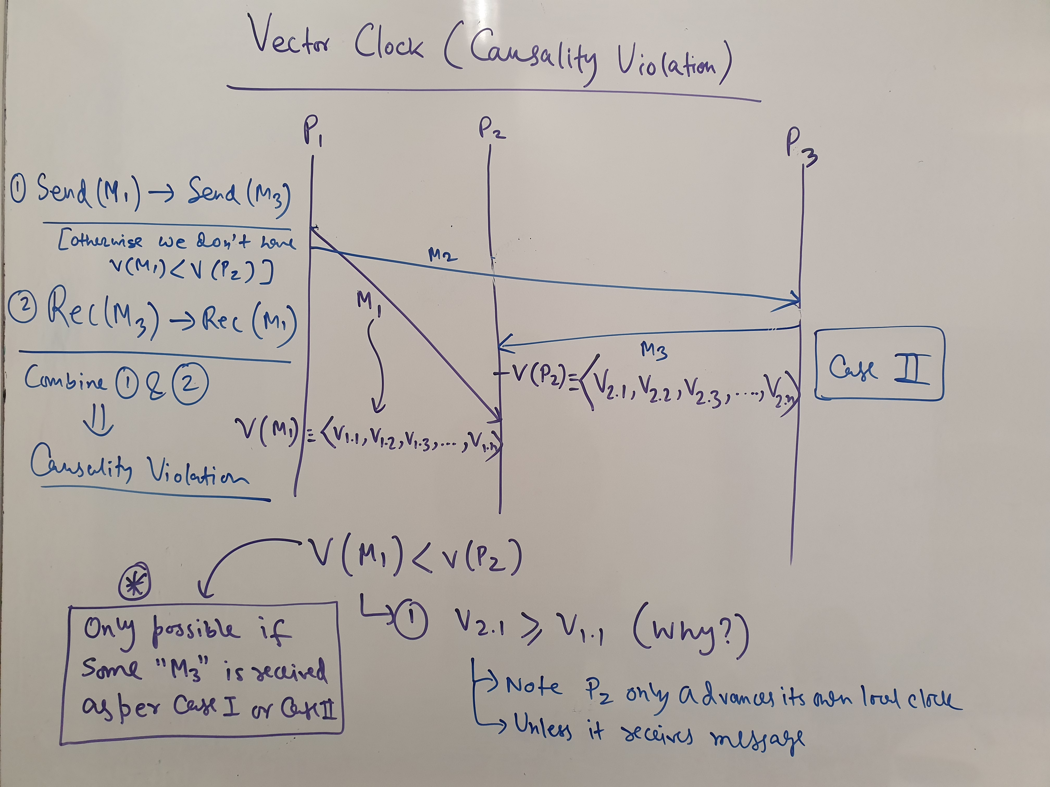

Slide 69
Vector Clock (Exercise)
Devise a protocol to create a total order among all the events that are assigned vector clocks. Make your algorithm general to work for an arbitrary number of machines.
Notes:
Total Ordering Protocol Using Vector Clocks
Assign Unique Identifiers: Each machine in the distributed system is assigned a unique identifier (UID). This UID is static and totally ordered. For instance, UIDs can be integers that are unique for each process.
Use Vector Clocks: Each event is timestamped with a vector clock. The i-th element of the vector clock is incremented by the i-th process on each internal event and is updated accordingly on the receipt of a message.
Augment the Vector Clock: Along with the vector clock, attach the UID of the process where the event occurs. This forms an augmented timestamp that consists of a pair: (Vector Clock, UID).
Define a Comparison Operator: To compare two augmented timestamps (VC1, UID1) and (VC2, UID2), first compare the vector clocks. If VC1 is less than VC2, then the event associated with VC1 happened before the event associated with VC2. The same applies if VC2 is less than VC1. If neither vector clock is less than the other (they are concurrent), then compare their UIDs.
Total Ordering Rule: An event E1 with timestamp (VC1, UID1) is considered to have happened before an event E2 with timestamp (VC2, UID2) if either:
VC1 is less than VC2, or
VC1 is equal to VC2, and UID1 is less than UID2.
Breaking Ties: The UID comparison acts as a tiebreaker when the vector clocks are equal or concurrent. Since UIDs are totally ordered and unique, there will always be a clear ordering between two events with the same or concurrent vector clocks.
Event Propagation: When a message is sent from process Pi to process Pj, include the augmented timestamp of the event. Upon receiving the message, Pj updates its vector clock based on the vector clock received and its own, then increments its own position in the vector clock due to the message receipt event.
Consistent Logging: All events are logged with their augmented timestamps. The log can then be sorted according to the total ordering rule to list all events in a total order.
By applying this protocol, every event in the distributed system can be totally ordered with respect to all other events. Even though vector clocks only provide partial ordering based on causality, the addition of UIDs and a consistent comparison operator allows us to establish a total order.

Slide 70
Detecting Causality Violation (Exercise)
Discuss and work out a proof sketch, possibly using induction and/or by contradiction, to show that the vector clock protocol accurately detects the (potential) causality violation.
Notes:
Definitions:
Let's denote VC(e) as the vector clock of event e.
An event e1 causally precedes e2 (denoted as e1→e2) if and only if e1 can influence e2.
The vector clock protocol states that e1→e2 if and only if VC(e1)<VC(e2), where "<" denotes the element-wise less-than operation on vector clocks.
Base Case (Initial State):
In the initial state, all vector clocks are set to zero. There are no previous events, so there can be no causality and hence no causality violation. The base case holds trivially.
Inductive Step:
Assume the vector clock protocol has accurately detected all causality relationships up to some point in the execution of the system. We need to show that the next event enew​ will also have its causality accurately detected.
There are two cases to consider when a new event enew​ occurs:
enew​ is an internal event or a send event in process Pi​. In this case, Pi​ increments its i-th element in the vector clock. Since no other elements are changed, VC(enew​) will be greater than the vector clock of any previous event in Pi​, and not less than the vector clock of any other event in the system, due to the induction hypothesis. Thus, the causality is preserved.
enew​ is a receive event in process Pj​ caused by a message sent from process Pi​. According to the protocol, Pj​ updates its vector clock to the maximum of its current value and the vector clock received from Pi​, and then increments its j-th element. This ensures that VC(enew​) reflects the causality from Pi​ and any causality that Pi​'s vector clock reflected.
Proof by Contradiction (Causality Violation):
Suppose for contradiction that the vector clock protocol indicated a causality violation when there was none, meaning that VC(e1)≥VC(e2) but e1↛ e2. By the protocol, the only way for e1's vector clock to be greater than or equal to e2's is if e1 occurred after e2 or if e1 causally influenced e2 (which is a contradiction to our assumption). Therefore, such a situation is impossible.
Conversely, suppose that e1→e2 but VC(e1)≮ VC(e2). This would mean that the causality from e1 to e2 was not reflected in the vector clocks, which violates the updating rules of the vector clock protocol and the induction hypothesis. Thus, this situation is also impossible.
Conclusion: The vector clock protocol accurately captures the causality relationships between events, as any event that causally precedes another will have a strictly smaller vector clock, and any event that is concurrent will have an incomparable vector clock. The proof by induction ensures that this relationship holds throughout the execution of the system, while the proof by contradiction shows that any supposed causality violation detected by the vector clock must indeed be a true causality relationship. Therefore, the vector clock protocol accurately detects potential causality violations.

